Slide 1
Central Tendency & Variability
Chad Williams
University of Victoria

Slide 2
Lecture Outline
Distributions
Central Tendency
Mode
Median
Mean
Variability
Range
SIQR
MAD
SD
Skewed Distributions
Reporting Descriptives

Slide 3
Decimal Rules
If we do any math more complex than addition or subtraction
e.g., multiplication, squaring
Computations should include 4 decimals
Report to 2 decimals
Exception: Report p-values to as many decimals as our tables provide us (Unit 3.1.)
If we do not do any math more complex than addition or subtraction
Report the number of decimals as given
Whole numbers stay whole numbers (30 -> 30)
Numbers with decimals keep those decimals (30.56 -> 30.56)

Slide 4
Lecture Outline
Distributions
Central Tendency
Mode
Median
Mean
Variability
Range
SIQR
MAD
SD
Skewed Distributions
Reporting Descriptives

Slide 5
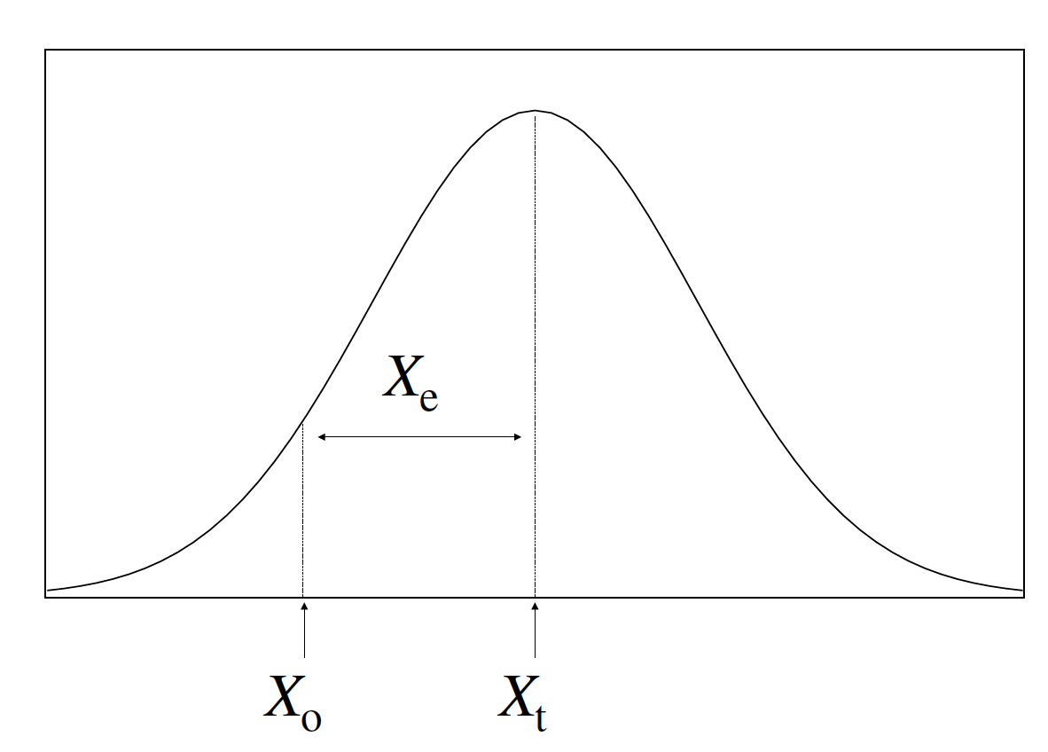
Describing Data
Descriptive Statistics: Defines a set of data using metrics
Central Tendency: A measure that best represents the data
Mode, Median, Mean
Variability: A measure that describes the spread of the data
Range, SIQR, MAD, SS, SD², SD

Slide 6
Building a Distribution
0 | 1 | -2 | 0
1 | 0 | -1 | 3
-1 | 1 | 2 | -3
0 | -2 | -1 | 2

Slide 7
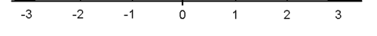
Building a Distribution
0 | 1 | -2 | 0
1 | 0 | -1 | 3
-1 | 1 | 2 | -3
0 | -2 | -1 | 2

Slide 8
Building a Distribution
0 | 1 | -2 | 0
1 | 0 | -1 | 3
-1 | 1 | 2 | -3
0 | -2 | -1 | 2

Slide 9
Building a Distribution
0 | 1 | -2 | 0
1 | 0 | -1 | 3
-1 | 1 | 2 | -3
0 | -2 | -1 | 2

Slide 10
Building a Distribution
0 | 1 | -2 | 0
1 | 0 | -1 | 3
-1 | 1 | 2 | -3
0 | -2 | -1 | 2

Slide 11
Building a Distribution
0 | 1 | -2 | 0
1 | 0 | -1 | 3
-1 | 1 | 2 | -3
0 | -2 | -1 | 2

Slide 12
Building a Distribution
0 | 1 | -2 | 0
1 | 0 | -1 | 3
-1 | 1 | 2 | -3
0 | -2 | -1 | 2

Slide 13
Building a Distribution
0 | 1 | -2 | 0
1 | 0 | -1 | 3
-1 | 1 | 2 | -3
0 | -2 | -1 | 2

Slide 14
Building a Distribution
0 | 1 | -2 | 0
1 | 0 | -1 | 3
-1 | 1 | 2 | -3
0 | -2 | -1 | 2

Slide 15
Building a Distribution
0 | 1 | -2 | 0
1 | 0 | -1 | 3
-1 | 1 | 2 | -3
0 | -2 | -1 | 2

Slide 16
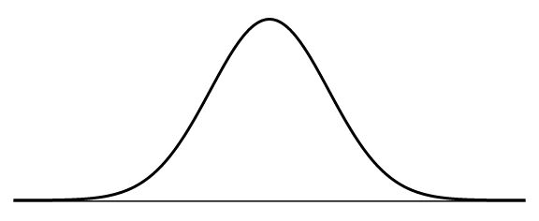
Building a Distribution

Slide 17
Building a Distribution

Slide 18
Lecture Outline
Distributions
Central Tendency
Mode
Median
Mean
Variability
Range
SIQR
MAD
SD
Skewed Distributions
Reporting Descriptives

Slide 19
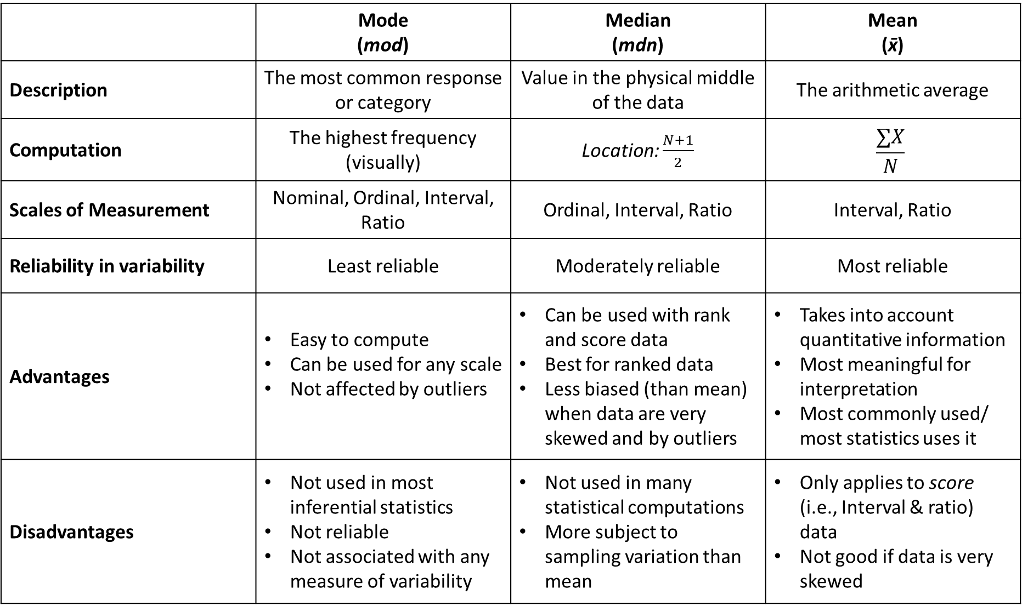
 | Mode (mod) | Median (mdn) | Mean (x̄)
Description | The most common response or category | Value in the physical middle of the data | The arithmetic average
Computation | The highest frequency (visually) | Location: $\frac{N+1}{2}$ | $$\frac{∑X}{N}$$
Scales of Measurement | Nominal, Ordinal, Interval, Ratio | Ordinal, Interval, Ratio | Interval, Ratio
Reliability in variability | Least reliable | Moderately reliable | Most reliable
Advantages | Easy to compute Can be used for any scale Not affected by outliers | Can be used with rank and score data Best for ranked data Less biased (than mean) when data are very skewed and by outliers | Takes into account quantitative information Most meaningful for interpretation Most commonly used/ most statistics uses it
Disadvantages | Not used in most inferential statistics Not reliable Not associated with any measure of variability | Not used in many statistical computations More subject to sampling variation than mean | Only applies to score (i.e., Interval & ratio) data Not good if data is very skewed

Slide 20
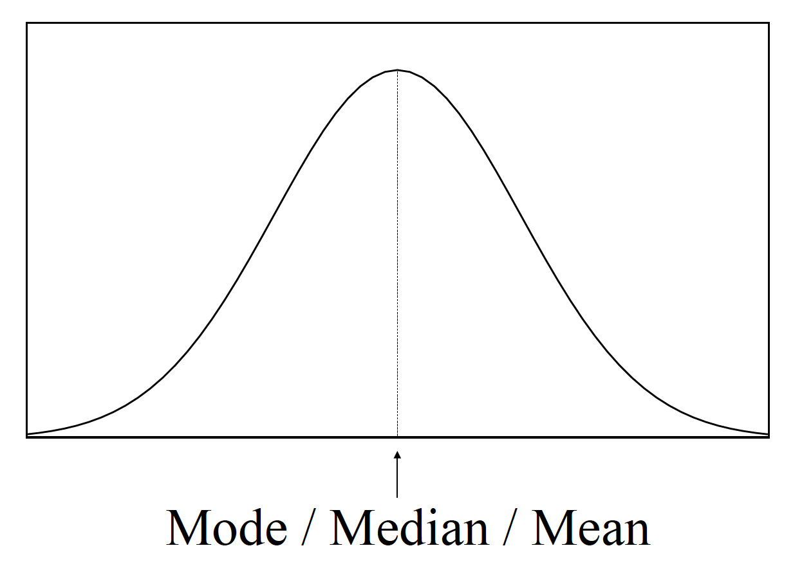
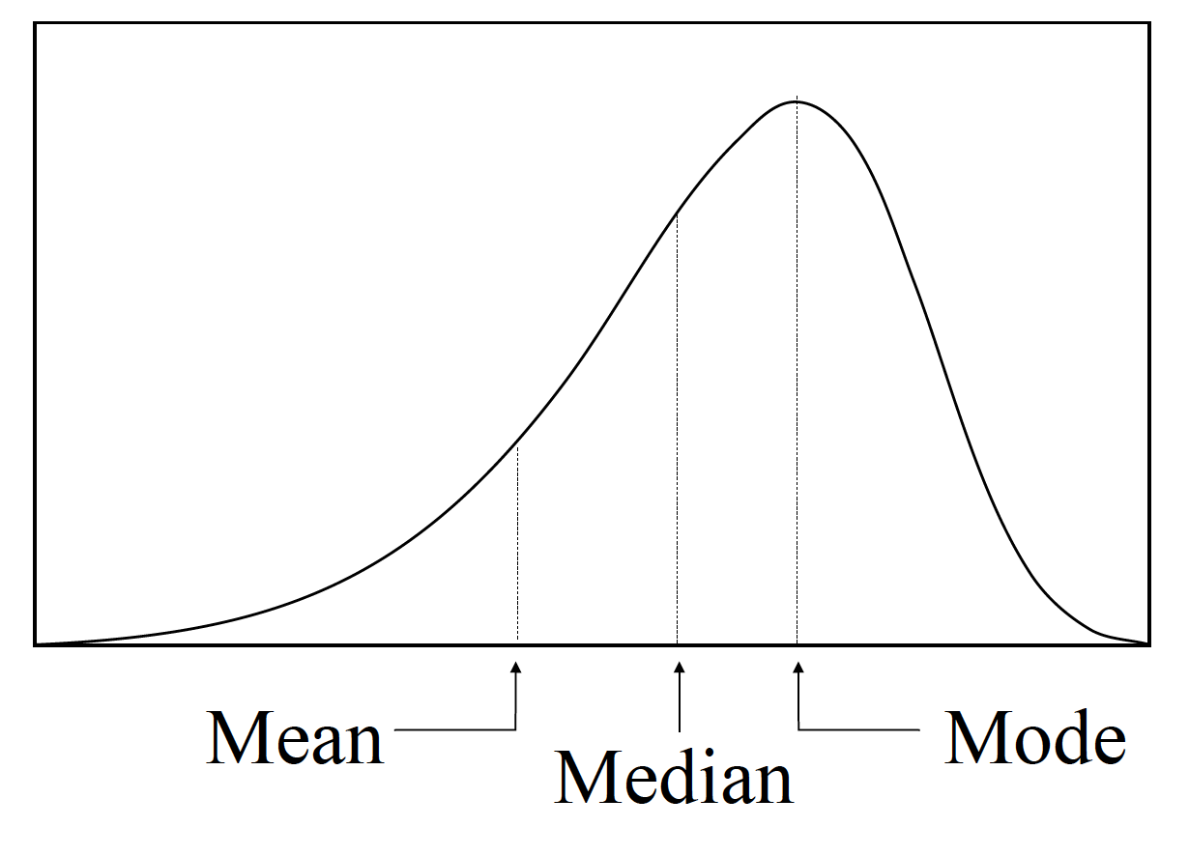
Central Tendency
Types of Central Tendency
Mode (mod)
Median (mdn)
Mean (x̅ or M)
Selecting a Central Tendency
Should best reflect the data
Should be appropriate to the scale of measurement
Should be as unbiased as possible

Slide 21
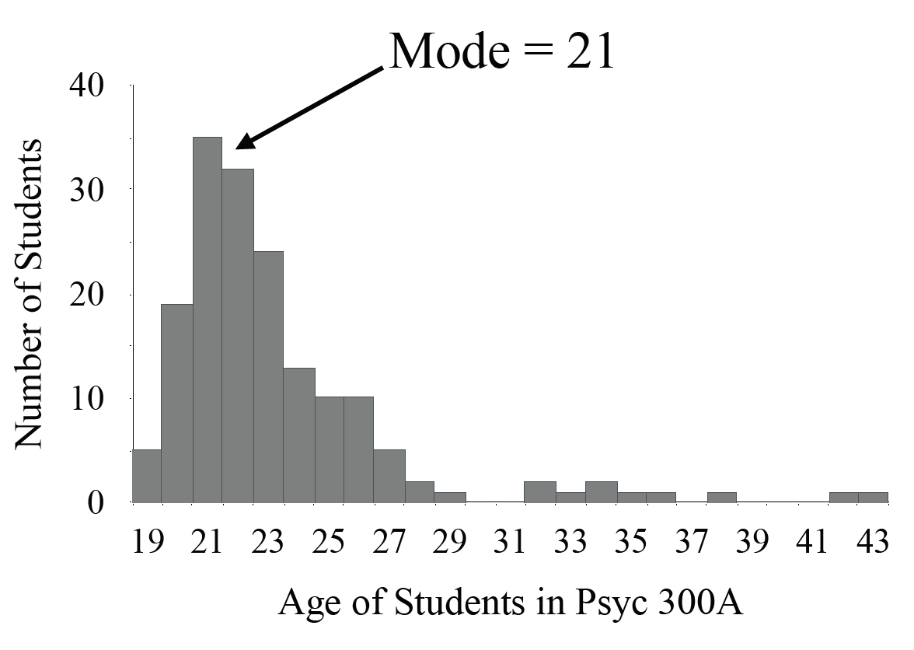
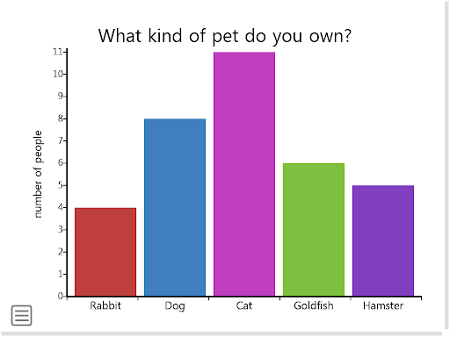
Mode (mod)
Description: The most common response or category
Computation: The highest frequency (visually)

Slide 22
Mode (mod)
Age | Freq.
25 | 1
24 | 0
23 | 0
22 | 0
21 | 1
20 | 3
19 | 4
18 | 1
Description: The most common response or category
Computation: The highest frequency (visually)

Slide 23
Mode (mod)
Scales of Measurement: Nominal, Ordinal, Interval, Ratio
Only method for nominal
Reliability in Variability: Least reliable
Potential for lots of variability

Slide 24
Mode (mod)
Advantages:
Easy to compute
Can be used for any scale
Not affected by outliers

Slide 25
Mode (mod)
Disadvantages:
Not used in most inferential statistics
Not reliable
Not associated with any measure of variability

Slide 26
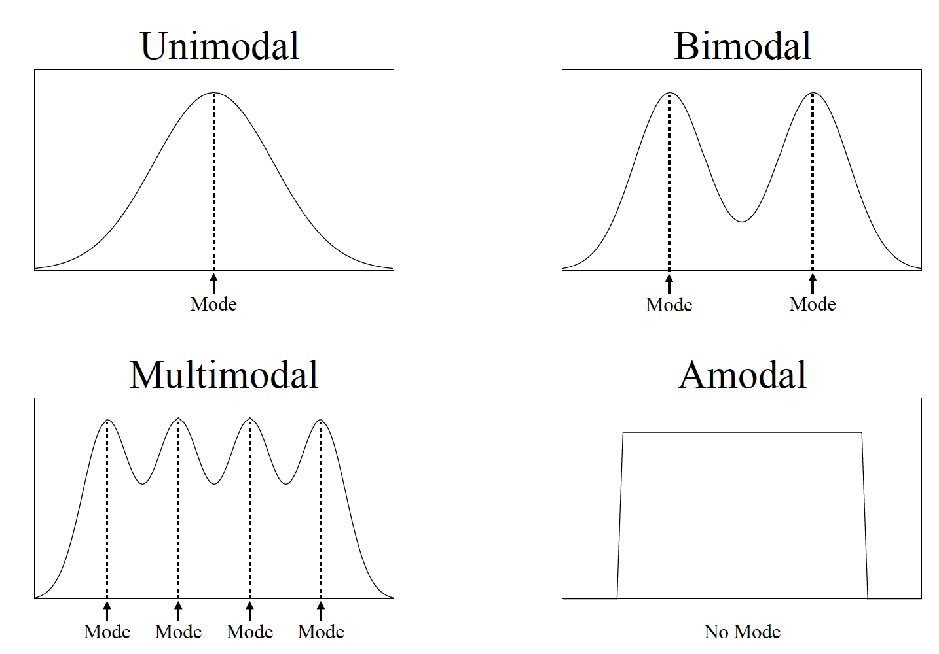
Mode (mod)

Slide 27
Lecture Outline
Distributions
Central Tendency
Mode
Median
Mean
Variability
Range
SIQR
MAD
SD
Skewed Distributions
Reporting Descriptives

Slide 28
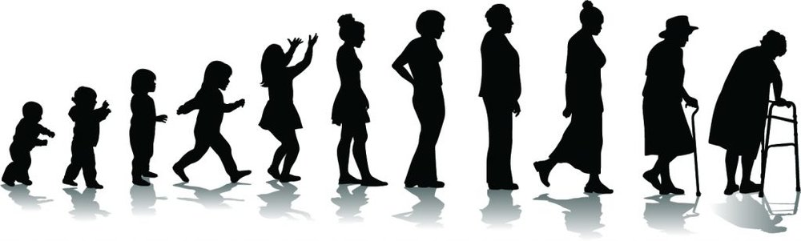
Median (mdn)
Description: Value in the physical middle of the data
1 2 3 4 5 6 7 8 9 10 11

Slide 29
Median (mdn)
Computation:
If odd number of values, number in the middle
1, 4, 5, 6, 7, 10, 12, median = 6
1 2 3 4 5 6 7 8 9 10 11

Slide 30
Median (mdn)
Computation:
If even number of values, midpoint of two middle values
1, 4, 5, 6, 7, 10, median = 5.50
1 2 3 4 5 6 7 8 9 10

Slide 31

Median (mdn)
Computation:
Can find location of the median using $\frac{N+1}{2}$
But then go see what that number is!
1 2 3 4 5 6 7 8 9 10

Slide 32
Median (mdn)
Scales of Measurement: Ordinal, Interval, Ratio
Most common for ordinal
Also used when data is very skewed (more later)
Reliability in Variability: Moderately reliable

Slide 33
Median (mdn)
Advantages:
Can be used with ordinal, interval, and ratio data
Best for ordinal data
Less biased (than mean) when data are very skewed
Not affected by outliers

Slide 34
Median (mdn)
Disadvantages:
Not used in many statistical computations
More subject to sampling variation than mean
i.e., it is not stable across samples

Slide 35
Lecture Outline
Distributions
Central Tendency
Mode
Median
Mean
Variability
Range
SIQR
MAD
SD
Skewed Distributions
Reporting Descriptives

Slide 36
Mean (x̄)
Description: The arithmetic average
1 2 3 6 10 20 35 50 65 75 85

Slide 37

Mean (x̄)
Computation: $\frac{∑X}{N}$
1 2 3 6 10 20 35 50 65 75 85

Slide 38

Mean (x̄)
Sigma: Sum everything
next to me
X: all of your data (see below: 1, 2, 3, 6…)
$$\frac{∑X}{N}$$
Sample Size: How much data
1 2 3 6 10 20 35 50 65 75 85

Slide 39

Mean (x̄)
Computation: $\frac{∑X}{N}$
$\frac{1+2+3+6+10+20+35+50+65+75+85}{11}=$
32.00
1 2 3 6 10 20 35 50 65 75 85

Slide 40
Mean (x̄)
Scales of Measurement: Interval, Ratio
Reliability in Variability: Most reliable
1 2 3 6 10 20 35 50 65 75 85

Slide 41
Mean (x̄)
Advantages:
Takes into account quantitative information
Most meaningful for interpretation
Most commonly used in statistical equations

Slide 42
Mean (x̄)
Disadvantages:
Only applies to score (i.e., Interval & ratio) data
Not good if data is very skewed (more on that later)

Slide 43
 | Mode (mod) | Median (mdn) | Mean (x̄)
Description | The most common response or category | Value in the physical middle of the data | The arithmetic average
Computation | The highest frequency (visually) | Location: $\frac{N+1}{2}$ | $$\frac{∑X}{N}$$
Scales of Measurement | Nominal, Ordinal, Interval, Ratio | Ordinal, Interval, Ratio | Interval, Ratio
Reliability in variability | Least reliable | Moderately reliable | Most reliable
Advantages | Easy to compute Can be used for any scale Not affected by outliers | Can be used with rank and score data Best for ranked data Less biased (than mean) when data are very skewed and by outliers | Takes into account quantitative information Most meaningful for interpretation Most commonly used/ most statistics uses it
Disadvantages | Not used in most inferential statistics Not reliable Not associated with any measure of variability | Not used in many statistical computations More subject to sampling variation than mean | Only applies to score (i.e., Interval & ratio) data Not good if data is very skewed

Slide 44
Reframing with Scales of Measurement
 | Nominal | Ordinal | Interval | Ratio
Description | Categorical | Rank-Ordered | Equal Distances (no true zero) | Equal Distances (true zero)
Data Type | Qualitative | Qualitative | Quantitative | Quantitative
Central Tendency | Mode | Mode Median | Mode Median Mean | Mode Median Mean

Slide 45
Reframing with Scales of Measurement
 | Nominal | Ordinal | Interval | Ratio
Description | Categorical | Rank-Ordered | Equal Distances (no true zero) | Equal Distances (true zero)
Data Type | Qualitative | Qualitative | Quantitative | Quantitative
Central Tendency | Mode | Mode Median | Mode Median Mean | Mode Median Mean

Slide 46
Reframing with Scales of Measurement
 | Nominal | Ordinal | Interval | Ratio
Description | Categorical | Rank-Ordered | Equal Distances (no true zero) | Equal Distances (true zero)
Type | Qualitative | Qualitative | Quantitative | Quantitative
Central Tendency | Mode | Mode Median | Mode Median Mean | Mode Median Mean

Slide 47
Reframing with Scales of Measurement
 | Nominal | Ordinal | Interval | Ratio
Description | Categorical | Rank-Ordered | Equal Distances (no true zero) | Equal Distances (true zero)
Data Type | Qualitative | Qualitative | Quantitative | Quantitative
Central Tendency | Mode | Mode Median | Mode Median Mean | Mode Median Mean
Variability | … | … | … | …

Slide 48
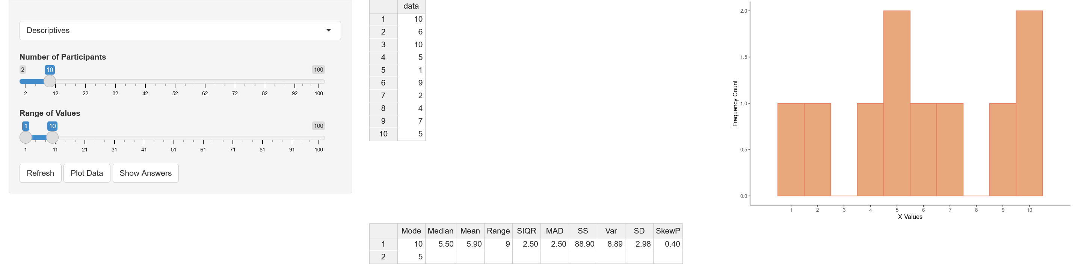
Stats Problem Generator
https://chadcwilliams.shinyapps.io/StatsProblemGenerator/

Slide 49
Lecture Outline
Distributions
Central Tendency
Mode
Median
Mean
Variability
Range
SIQR
MAD
SD
Skewed Distributions
Reporting Descriptives

Slide 50
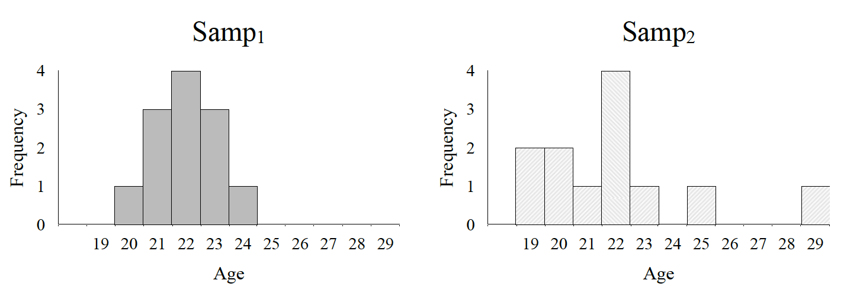
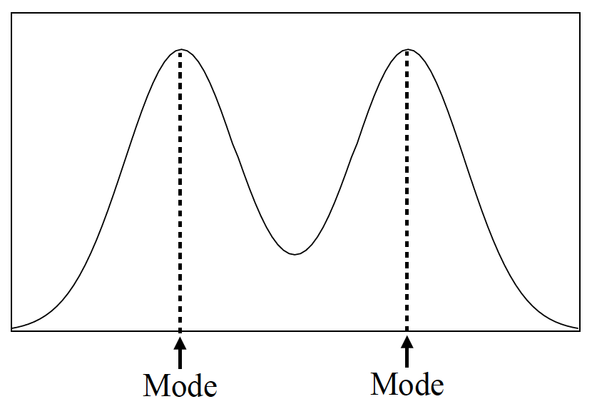
The Problem with Central Tendency
Both samples on the right have identical mode, median, and mean.
The distribution on the bottom shows how the median and mean really do not represent the distribution well at all
Median
Mean

Slide 51
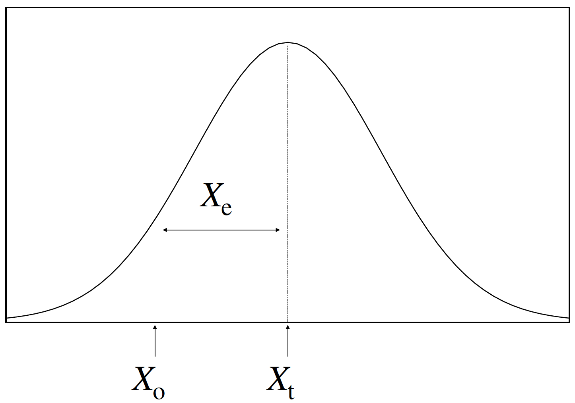
Variability in Participant Scores
For a single participant measurement
X_{o} = X_{t} + X_{e}
X_{o} = Observed score
X_{t} = True score
X_{e} = Error

Slide 52
Variability in Participant Scores
For a single participant measurement
X_{o} = X_{t} + X_{e}
X_{o} = Observed score
X_{t} = True score
X_{e} = Error

Slide 53
Variability in Distributions
For a group of participant measurements
X_{o} = X_{t} + X_{e}
X_{o} = Observed score (one P)
X_{t} = Central tendency
X_{e} = Variability

Slide 54
Variability in Distributions
For a group of participant measurements
X_{o} = X_{t} + X_{e}
X_{o} = Observed score (one P)
X_{t} = Central tendency
X_{e} = Variability

Slide 55
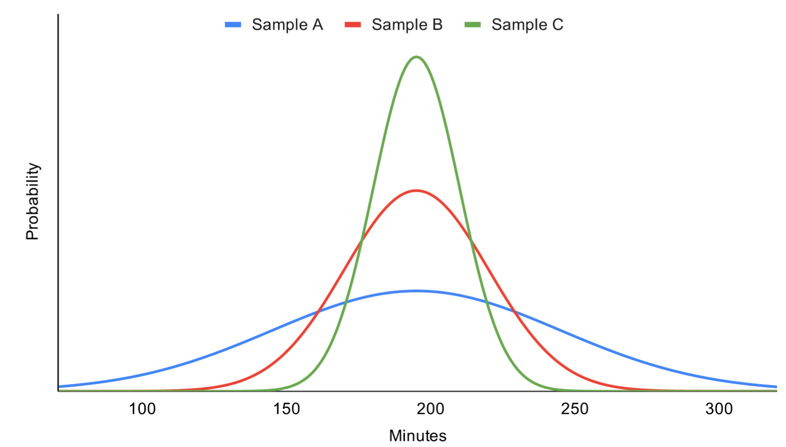
Choosing a Measure of Variability
Variability: Measure that describes how spread out our data are
Gives a distance among scores
Choosing a variability measure:
Appropriate to the measure of CT
Provide a useful description of the spread in data
The measure chosen should provide the smallest indicator of variability
Represent the data in meaningful units

Slide 56
Lecture Outline
Distributions
Central Tendency
Mode
Median
Mean
Variability
Range
SIQR
MAD
SD
Skewed Distributions
Reporting Descriptives

Slide 57
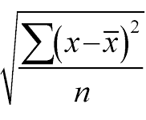
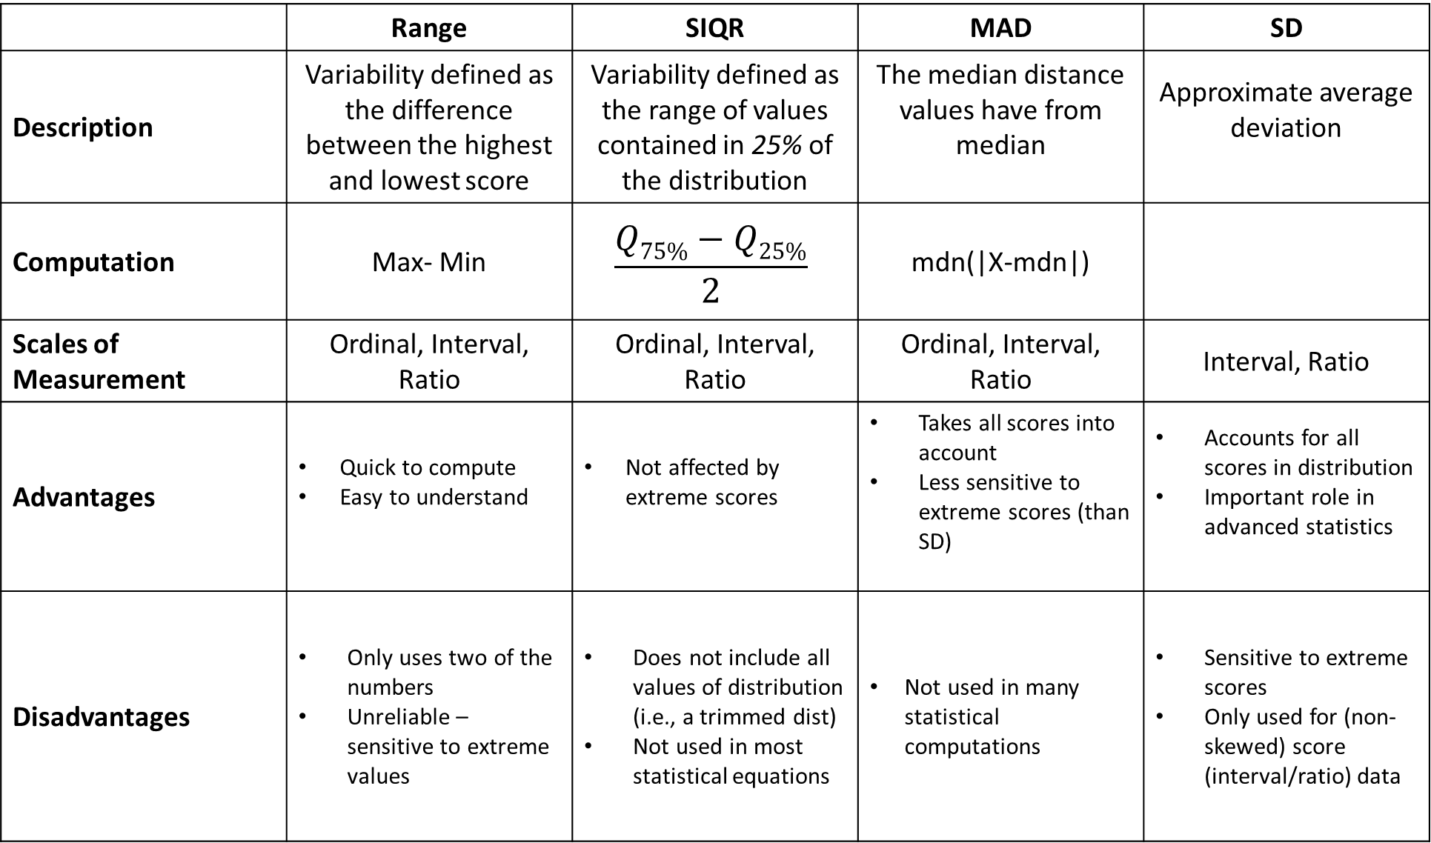
 | Range | SIQR | MAD | SD
Description | Variability defined as the difference between the highest and lowest score | Variability defined as the range of values contained in 25% of the distribution | The median distance values have from median | Approximate average deviation
Computation | Max- Min | $$\frac{Q75\%−Q25\%}{2}$$ | mdn(|X-mdn|)
Scales of Measurement | Ordinal, Interval, Ratio | Ordinal, Interval, Ratio | Ordinal, Interval, Ratio | Interval, Ratio
Advantages | Quick to compute Easy to understand | Not affected by extreme scores | Takes all scores into account Less sensitive to extreme scores (than SD) | Accounts for all scores in distribution Important role in advanced statistics
Disadvantages | Only uses two of the numbers Unreliable – sensitive to extreme values | Does not include all values of distribution (i.e., a trimmed dist) Not used in most statistical equations | Not used in many statistical computations | Sensitive to extreme scores Only used for (non-skewed) score (interval/ratio) data

Slide 58
Mode | Median | Mean
none | Range SIQR MAD | Range SIQR SD (SS and SD²)

Slide 59
Mode | Median | Mean
none | Range SIQR MAD | Range SIQR SD (SS and SD²)

Slide 60
Nominal, Mode, and Variability

Slide 61
Mode | Median | Mean
none | Range SIQR MAD | Range SIQR SD (SS and SD²)

Slide 62
Ordinal/Score, Median/Mean, and Variability
Range: Variability defined as the difference between the highest and lowest score
1 1 1 2 3 3 3 4 4 4 4
Computation: Max-Min
Max = 4, Min = 1
Range: 4-1=3
1 2 3 4 5

Slide 63
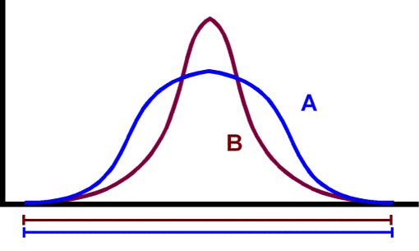
Ordinal/Score, Median/Mean, and Variability
Range
Advantage:
Quick to compute
Easy to understand
Range

Slide 64
Ordinal/Score, Median/Mean, and Variability
Range
Disadvantage:
Only uses two of the numbers
Unreliable, sensitive to extreme values
Range

Slide 65
Mode | Median | Mean
none | Range SIQR MAD | Range SIQR SD (SS and SD²)

Slide 66
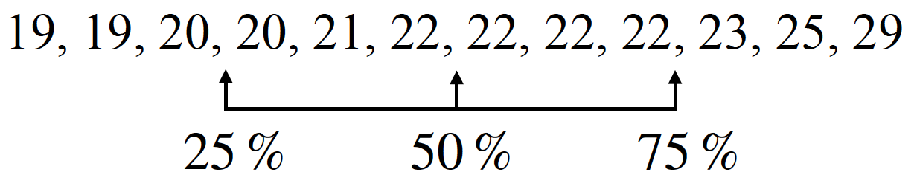

Ordinal/Score, Median/Mean, and Variability
Semi-Interquartile Range (SIQR): Variability defined as the range of values contained in 25% of the distribution
Computation: $\frac{Q_{75\%}−Q_{25\%}}{2}$
Q_{75%}: The 75th percentile
Q_{25%}: The 25th percentile

Slide 67
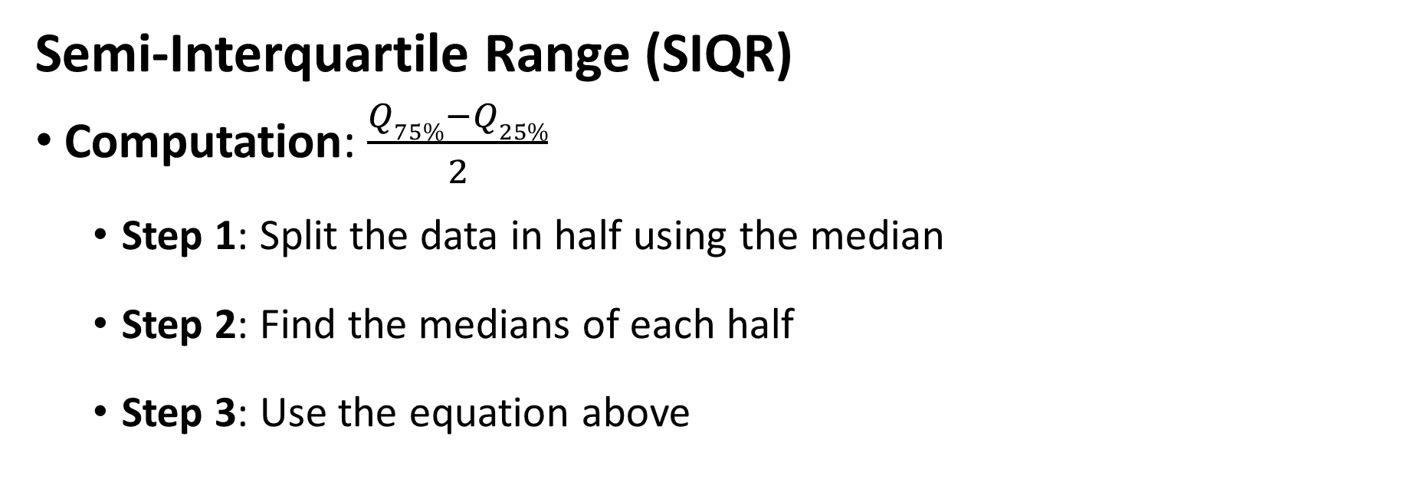

Ordinal/Score, Median/Mean, and Variability
Semi-Interquartile Range (SIQR)
Computation: $\frac{Q_{75\%}−Q_{25\%}}{2}$
Step 1: Split the data in half using the median
Step 2: Find the medians of each half
Step 3: Use the equation above
Q_{25%}
Median
Q_{75%}

Slide 68
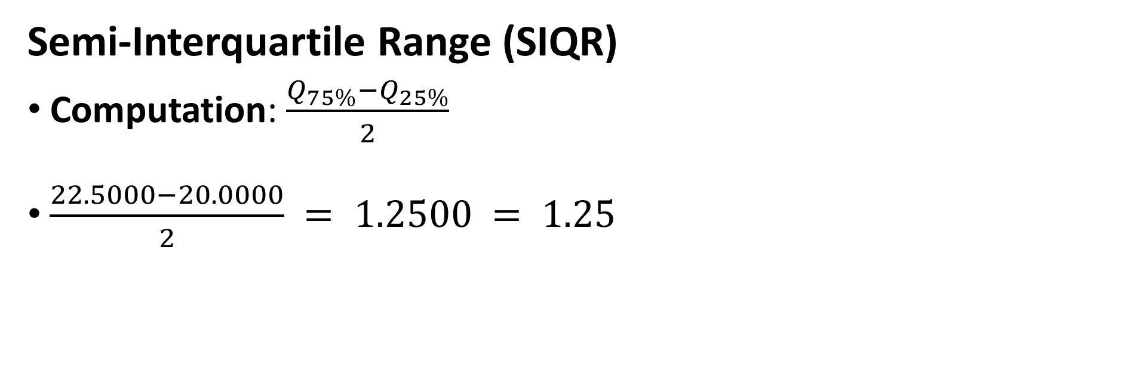
Ordinal/Score, Median/Mean, and Variability
Semi-Interquartile Range (SIQR)
Computation: $\frac{Q_{75\%}−Q_{25\%}}{2}$
$\frac{22.5000−20.0000}{2} = 1.2500 = 1.25$
Q_{25%}
Median
Q_{75%}

Slide 69

Ordinal/Score, Median/Mean, and Variability
Semi-Interquartile Range (SIQR)
Computation: $\frac{Q_{75\%}−Q_{25\%}}{2}$
Note: If the data has an odd number of samples, then ignore the middle number as shown below
Q_{25%}
Median
Q_{75%}

Slide 70
Ordinal/Score, Median/Mean, and Variability
Semi-Interquartile Range (SIQR)
Advantages
Not affected by extreme scores

Slide 71
Ordinal/Score, Median/Mean, and Variability
Semi-Interquartile Range (SIQR)
Disadvantage
Does not include all values of distribution (i.e., a trimmed dist)
Not used in most statistical equations

Slide 72
Mode | Median | Mean
none | Range SIQR MAD | Range SIQR SD (SS and SD²)

Slide 73
Deviations

Slide 74
Ordinal, Median, and Variability
x | x-Mdn | |x-Mdn|
1 4 5 7 8 10
Median Absolute Deviation (MAD): The median distance values are from the median
Best measure of variability for median
The median of deviations (sort of)
Computation: mdn(|x-mdn|)

Slide 75
Ordinal, Median, and Variability
x | x-Mdn | |x-Mdn|
1 4 5 7 8 10
Median Absolute Deviation (MAD)
Step 1: Find median
Step 2: Find deviations from the median
Step 3: Convert to absolute values
Step 4: Find median of absolute deviations

Slide 76
Ordinal, Median, and Variability
x | x-Mdn | |x-Mdn|
1 4 5 7 8 10 Mdn=6
Median Absolute Deviation (MAD)
Step 1: Find median
Median = 6

Slide 77
Ordinal, Median, and Variability
x | x-Mdn | |x-Mdn|
1 4 5 7 8 10 Mdn=6 | 1-6 = -5 4-6 = -2 5-6 = -1 7-6 = 1 8-6 = 2 10-6 = 4
Median Absolute Deviation (MAD)
Step 1: Find median
Step 2: Find deviations from the median

Slide 78
Ordinal, Median, and Variability
x | x-Mdn | |x-Mdn|
1 4 5 7 8 10 Mdn=6 | 1-6 = -5 4-6 = -2 5-6 = -1 7-6 = 1 8-6 = 2 10-6 = 4 | 5 2 1 1 2 4
Median Absolute Deviation (MAD)
Step 1: Find median
Step 2: Find deviations from the median
Step 3: Convert to absolute values

Slide 79
Ordinal, Median, and Variability
x | x-Mdn | |x-Mdn|
1 4 5 7 8 10 Mdn=6 | 1-6 = -5 4-6 = -2 5-6 = -1 7-6 = 1 8-6 = 2 10-6 = 4 | 5 2 1 1 2 4
Median Absolute Deviation (MAD)
Step 1: Find median
Step 2: Find deviations from the median
Step 3: Convert to absolute values
Step 4: Find median of absolute deviations
1 1 2 2 4 5
MAD = 2

Slide 80
Ordinal, Median, and Variability
x | x-Mdn | |x-Mdn|
1 4 5 7 8 10 Mdn=6 | 1-6 = -5 4-6 = -2 5-6 = -1 7-6 = 1 8-6 = 2 10-6 = 4 | 5 2 1 1 2 4 MAD=2
Median Absolute Deviation (MAD)
Advantages:
Takes all scores into account
Less sensitive to extreme scores (than SD)
Disadvantages
Not used in many statistical computations

Slide 81
Note: Table with correct decimal usage
Median Absolute Deviation (MAD)
x | x-Mdn | |x-Mdn|
1 4 5 7 8 10 Mdn = 6.0000 | 1 - 6.0000 = -5.0000 4 - 6.0000 = -2.0000 5 - 6.0000 = -1.0000 7 - 6.0000 = 1.0000 8 - 6.0000 = 2.0000 10 - 6.0000 = 4.0000 | 5.0000 2.0000 1.0000 1.0000 2.0000 4.0000 MAD = 2.0000 REPORT: 2.00

Slide 82
Mode | Median | Mean
none | Range SIQR MAD | Range SIQR SD (SS and SD²)

Slide 83
Interval/Ratio, Mean, and Variability
Standard Deviation: Approximate average deviation
Best measure of variability for mean
The mean of the deviations (sort of)

Slide 84

Interval/Ratio, Mean, and Variability
Standard Deviation: Approximate average deviation
Computation:
$$\sqrt{\frac{∑{(x−x̅)}^{2}}{n}}$$

Slide 85
Interval/Ratio, Mean, and Variability
X
Deviations
Squared
Deviations
Sum of Squares
(SS)
Variance
(SD²)
Standard
Deviation (SD)

Slide 86
Interval/Ratio, Mean, and Variability
X
Deviations
Squared
Deviations
Sum of Squares
(SS)
Variance
(SD²)
Standard
Deviation (SD)
Step 1: Determine mean
Step 2: Determine deviations from the mean
Step 3: Square these deviations
Step 4: Sum the squared deviations (=Sums of Squares)
Step 5: Divide result by N (=Variance)
Step 6: Square root (=Standard Deviation)

Slide 87
Interval/Ratio, Mean, and Variability
X
Deviations
Squared
Deviations
Sum of Squares
(SS)
Variance
(SD²)
Standard
Deviation (SD)
0, 4, 5, 8, 8
x | (x - x̅̅) | (x - x̅̅)²
0 4 5 8 8
x̅̅ = 5

Slide 88

Interval/Ratio, Mean, and Variability
$$x − \bar{x}$$
X
Squared
Deviations
Sum of Squares
(SS)
Variance
(SD²)
Standard
Deviation (SD)
Deviations
0, 4, 5, 8, 8
x | (x - x̅̅) | (x - x̅̅)²
0 4 5 8 8 | 0-5 = -5 4-5 = -1 5-5 = 0 8-5 = 3 8-5 = 3
x̅̅ = 5

Slide 89


Interval/Ratio, Mean, and Variability
$$x − \bar{x}$$
$${deviations}^{2}$$
X
Deviations
Sum of Squares
(SS)
Variance
(SD²)
Standard
Deviation (SD)
Squared
Deviations
0, 4, 5, 8, 8
x | (x - x̅̅) | (x - x̅̅)²
0 4 5 8 8 | 0-5 = -5 4-5 = -1 5-5 = 0 8-5 = 3 8-5 = 3 | 25 1 0 9 9
x̅̅ = 5

Slide 90

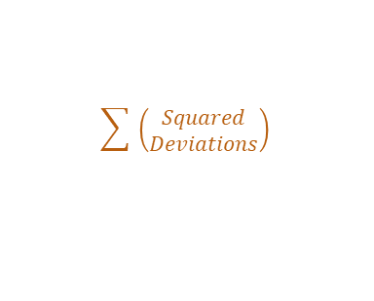
Interval/Ratio, Mean, and Variability
$$x − \bar{x}$$
$${deviations}^{2}$$
$$\sum{ \left(\begin{aligned}Squared \\ Deviations\end{aligned}\right)}$$
X
Deviations
Squared
Deviations
Variance
(SD²)
Standard
Deviation (SD)
Sum of Squares
(SS)
0, 4, 5, 8, 8
x | (x - x̅̅) | (x - x̅̅)²
0 4 5 8 8 | 0-5 = -5 4-5 = -1 5-5 = 0 8-5 = 3 8-5 = 3 | 25 1 0 9 9
x̅̅ = 5 |  | SS = 44

Slide 91

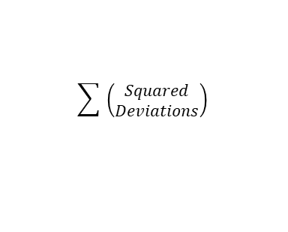
Interval/Ratio, Mean, and Variability
$$x − \bar{x}$$
$${deviations}^{2}$$
$$\sum{ \left(\begin{aligned}Squared \\ Deviations\end{aligned}\right)}$$
$$\frac{SS}{n}$$
X
Deviations
Squared
Deviations
Sum of Squares
(SS)
Standard
Deviation (SD)
Variance
(SD²)
0, 4, 5, 8, 8
x | (x - x̅̅) | (x - x̅̅)²
0 4 5 8 8 | 0-5 = -5 4-5 = -1 5-5 = 0 8-5 = 3 8-5 = 3 | 25 1 0 9 9
x̅̅ = 5 |  | SS = 44 SD² = 8.80

Slide 92


Interval/Ratio, Mean, and Variability
$$x − \bar{x}$$
$${deviations}^{2}$$
$$\sum{ \left(\begin{aligned}Squared \\ Deviations\end{aligned}\right)}$$
$$\frac{SS}{n}$$
$$\sqrt{{SD}^{2}}$$
X
Deviations
Squared
Deviations
Sum of Squares
(SS)
Variance
(SD²)
Standard
Deviation (SD)
0, 4, 5, 8, 8
x | (x - x̅̅) | (x - x̅̅)²
0 4 5 8 8 | 0-5 = -5 4-5 = -1 5-5 = 0 8-5 = 3 8-5 = 3 | 25 1 0 9 9
x̅̅ = 5 |  | SS = 44 SD² = 8.80 SD = 2.97

Slide 93

Interval/Ratio, Mean, and Variability
$$x − \bar{x}$$
$${deviations}^{2}$$
$$\sum{ \left(\begin{aligned}Squared \\ Deviations\end{aligned}\right)}$$
$$\frac{SS}{n}$$
$$\sqrt{{SD}^{2}}$$
X
Deviations
Squared
Deviations
Sum of Squares
(SS)
Variance
(SD²)
Standard
Deviation (SD)
0, 4, 5, 8, 8
x | (x - x̅̅) | (x - x̅̅)²
0 4 5 8 8 | 0-5 = -5 4-5 = -1 5-5 = 0 8-5 = 3 8-5 = 3 | 25 1 0 9 9
x̅̅ = 5 |  | SS = 44 SD² = 8.80 SD = 2.97

Slide 94
Note: Table with correct decimal usage
$$x − \bar{x}$$
$${deviations}^{2}$$
$$\sum{ \left(\begin{aligned}Squared \\ Deviations\end{aligned}\right)}$$
$$\frac{SS}{n}$$
$$\sqrt{{SD}^{2}}$$
X
Deviations
Squared
Deviations
Sum of Squares
(SS)
Variance
(SD²)
Standard
Deviation (SD)
0, 4, 5, 8, 8
Report:
SD = 2.97
x | (x - x̅̅) | (x - x̅̅)²
0 4 5 8 8 | 0 - 5.0000 = -5.0000 4 - 5.0000 = -1.0000 5 - 5.0000 = 0.0000 8 - 5.0000 = 3.0000 8 - 5.0000 = 3.0000 | 25.0000 1.0000 0.0000 9.0000 9.0000
x̅̅ = 5.0000 |  | SS = 44.0000 SD² = 8.8000 SD = 2.9700

Slide 95

Interval/Ratio, Mean, and Variability
$$x − \bar{x}$$
$${deviations}^{2}$$
$$\sum{ \left(\begin{aligned}Squared \\ Deviations\end{aligned}\right)}$$
$$\frac{SS}{n}$$
$$\sqrt{{SD}^{2}}$$
X
Deviations
Squared
Deviations
Sum of Squares
(SS)
Variance
(SD²)
Standard
Deviation (SD)
$$\sqrt{\frac{∑{(x−x̅)}^{2}}{n}}$$

Slide 96

Interval/Ratio, Mean, and Variability
$$x − \bar{x}$$
$${deviations}^{2}$$
$$\sum{ \left(\begin{aligned}Squared \\ Deviations\end{aligned}\right)}$$
$$\frac{SS}{n}$$
$$\sqrt{{SD}^{2}}$$
X
Deviations
Squared
Deviations
Sum of Squares
(SS)
Variance
(SD²)
Standard
Deviation (SD)
$$\sqrt{\frac{∑{(x−x̅)}^{2}}{n}}$$

Slide 97

Interval/Ratio, Mean, and Variability
$$x − \bar{x}$$
$${deviations}^{2}$$
$$\sum{ \left(\begin{aligned}Squared \\ Deviations\end{aligned}\right)}$$
$$\frac{SS}{n}$$
$$\sqrt{{SD}^{2}}$$
X
Deviations
Squared
Deviations
Sum of Squares
(SS)
Variance
(SD²)
Standard
Deviation (SD)
$$\sqrt{\frac{∑{(x−x̅)}^{2}}{n}}$$

Slide 98

Interval/Ratio, Mean, and Variability
$$x − \bar{x}$$
$${deviations}^{2}$$
$$\sum{ \left(\begin{aligned}Squared \\ Deviations\end{aligned}\right)}$$
$$\frac{SS}{n}$$
$$\sqrt{{SD}^{2}}$$
X
Deviations
Squared
Deviations
Sum of Squares
(SS)
Variance
(SD²)
Standard
Deviation (SD)
$$\sqrt{\frac{∑{(x−x̅)}^{2}}{n}}$$

Slide 99

Interval/Ratio, Mean, and Variability
$$x − \bar{x}$$
$${deviations}^{2}$$
$$\sum{ \left(\begin{aligned}Squared \\ Deviations\end{aligned}\right)}$$
$$\frac{SS}{n}$$
$$\sqrt{{SD}^{2}}$$
X
Deviations
Squared
Deviations
Sum of Squares
(SS)
Variance
(SD²)
Standard
Deviation (SD)
$$\sqrt{\frac{∑{(x−x̅)}^{2}}{n}}$$

Slide 100

Interval/Ratio, Mean, and Variability
$$x − \bar{x}$$
$${deviations}^{2}$$
$$\sum{ \left(\begin{aligned}Squared \\ Deviations\end{aligned}\right)}$$
$$\frac{SS}{n}$$
$$\sqrt{{SD}^{2}}$$
X
Deviations
Squared
Deviations
Sum of Squares
(SS)
Variance
(SD²)
Standard
Deviation (SD)
$$\sqrt{\frac{∑{(x−x̅)}^{2}}{n}}$$

Slide 101


Interval/Ratio, Mean, and Variability
$$x − \bar{x}$$
$${deviations}^{2}$$
$$\sum{ \left(\begin{aligned}Squared \\ Deviations\end{aligned}\right)}$$
$$\frac{SS}{n}$$
$$\sqrt{{SD}^{2}}$$
X
Deviations
Squared
Deviations
Sum of Squares
(SS)
Variance
(SD²)
Standard
Deviation (SD)
$${SD}^{2}× n$$
$${SD}^{2}$$

Slide 102
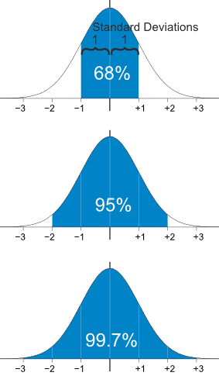
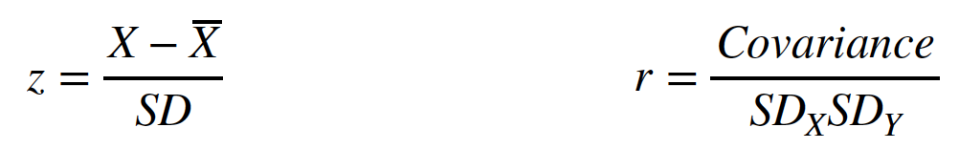
Standard Deviation
Approximate average that a set of scores varies from its mean
Most common measure of variability
Most often used in statistical equations
Advantages:
Accounts for all scores in distribution
Important role in inferential statistics
Disadvantages
Sensitive to extreme scores
Only used for (non-skewed) score (interval/ratio) data

Slide 103
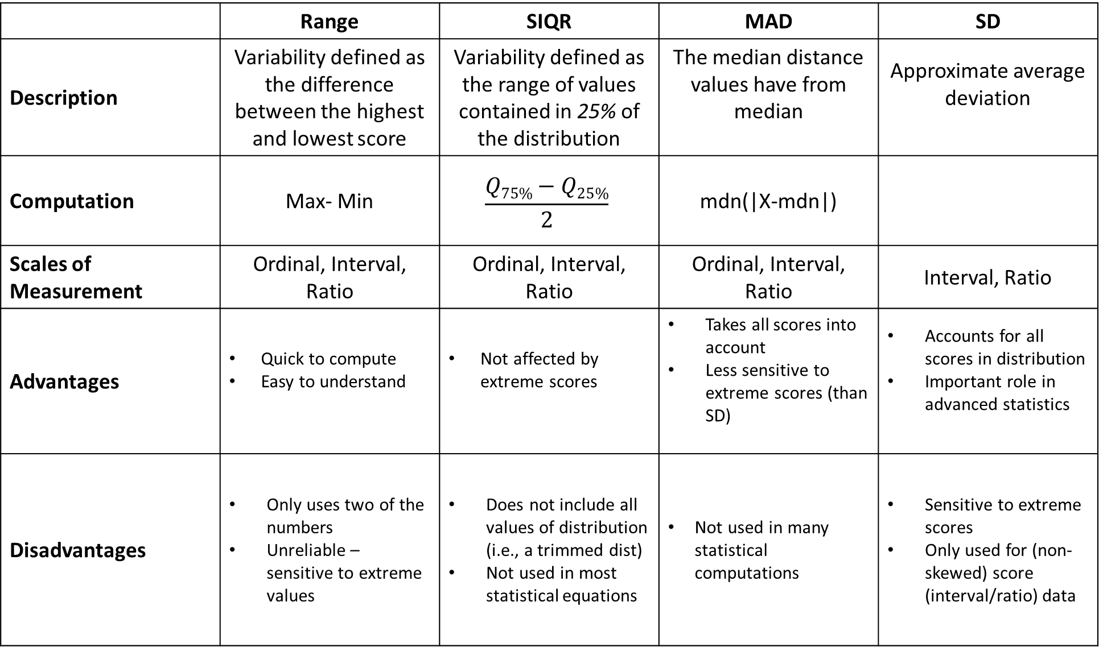
 | Range | SIQR | MAD | SD
Description | Variability defined as the difference between the highest and lowest score | Variability defined as the range of values contained in 25% of the distribution | The median distance values have from median | Approximate average deviation
Computation | Max- Min | $$\frac{Q75\%−Q25\%}{2}$$ | mdn(|X-mdn|)
Scales of Measurement | Ordinal, Interval, Ratio | Ordinal, Interval, Ratio | Ordinal, Interval, Ratio | Interval, Ratio
Advantages | Quick to compute Easy to understand | Not affected by extreme scores | Takes all scores into account Less sensitive to extreme scores (than SD) | Accounts for all scores in distribution Important role in advanced statistics
Disadvantages | Only uses two of the numbers Unreliable – sensitive to extreme values | Does not include all values of distribution (i.e., a trimmed dist) Not used in most statistical equations | Not used in many statistical computations | Sensitive to extreme scores Only used for (non-skewed) score (interval/ratio) data

Slide 104
Reframing with Scales of Measurement
 | Nominal | Ordinal | Interval | Ratio
Description | Categorical | Rank-Ordered | Equal Distances (no true zero) | Equal Distances (true zero)
Data Type | Qualitative | Qualitative | Quantitative | Quantitative
Central Tendency | Mode | Mode Median | Mode Median Mean | Mode Median Mean
Variability | none | Range SIQR MAD | Range SIQR MAD (mdn) SD (mean) | Range SIQR MAD (mdn) SD (mean)

Slide 105
https://chadcwilliams.shinyapps.io/StatsProblemGenerator/

Slide 106
Lecture Outline
Distributions
Central Tendency
Mode
Median
Mean
Variability
Range
SIQR
MAD
SD
Skewed Distributions
Reporting Descriptives

Slide 107
Skewed Distributions
Skewness can bias our central tendency (and variability)
In some cases, if the skew is too severe, we cannot use the mean to represent the data
We compute skew with skew_{p}

Slide 108
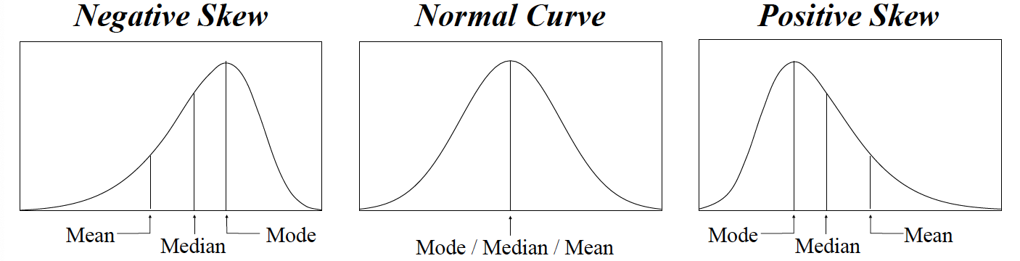
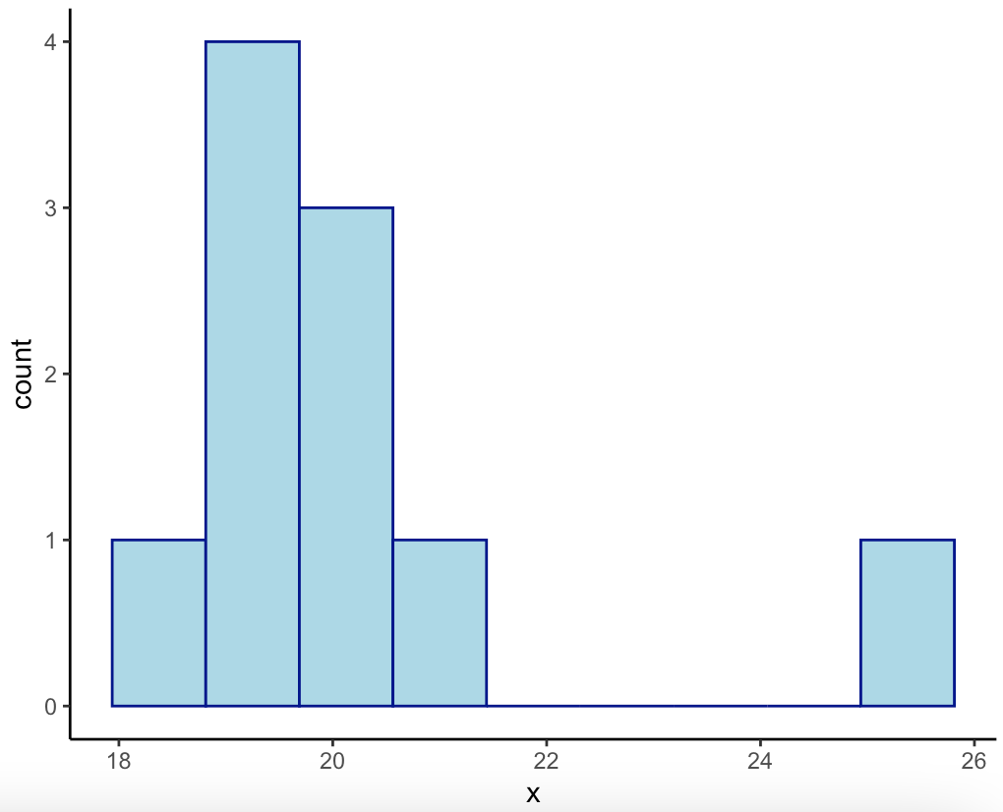
Skewed Distributions
A distribution of data where there exists extreme outliers
Most of the data is all bundled together, but a small subset is either way more positive or negative than the rest
18, 19, 19, 19, 19, 20, 20, 20, 21, 25, 1000

Slide 109
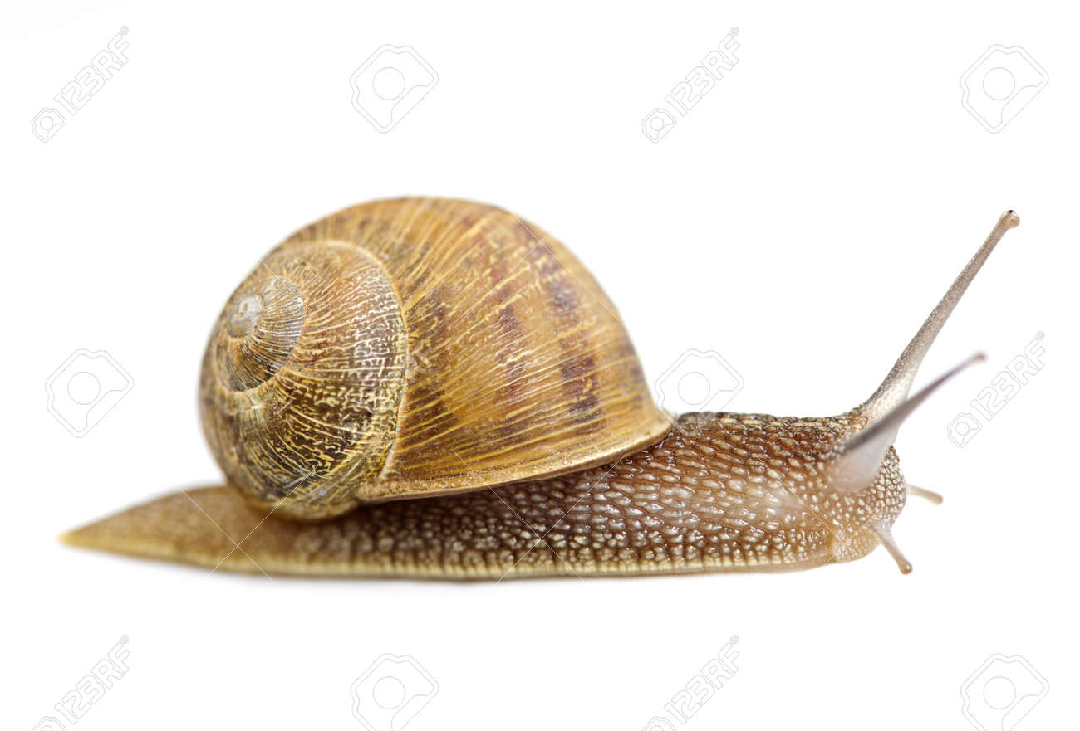
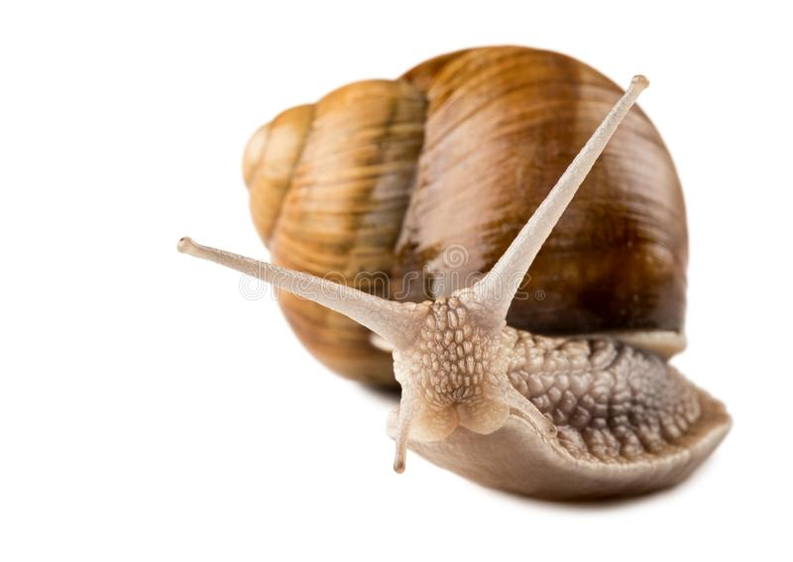
Skewed Distributions

Slide 110
Skewed Distributions
Central Tendency
Mode is unaffected
Median is moderately affected
Mean is severely affected

Slide 111
Outliers and Central Tendency
18, 19, 19, 19, 19, 20, 20, 20, 21, 25
Mode = 19
Median = 19.50
Mean = 20
18, 19, 19, 19, 19, 20, 20, 20, 21, 25, 30
Mode = 19
Median = 20
Mean = 20.91

Slide 112
Outliers and Central Tendency
18, 19, 19, 19, 19, 20, 20, 20, 21, 25
Mode = 19
Median = 19.50
Mean = 20
18, 19, 19, 19, 19, 20, 20, 20, 21, 25, 1000
Mode = 19
Median = 20
Mean = 109.09

Slide 113
Skewed Distributions
Pearson Skew (Skew_{p}): Method for measuring the degree to which a dataset is skewed
Although we most often try and use means, when data is severely skewed, we must use median – Skew_{p} will give us a measure of this
Only for score (interval/ ratio) data

Slide 114
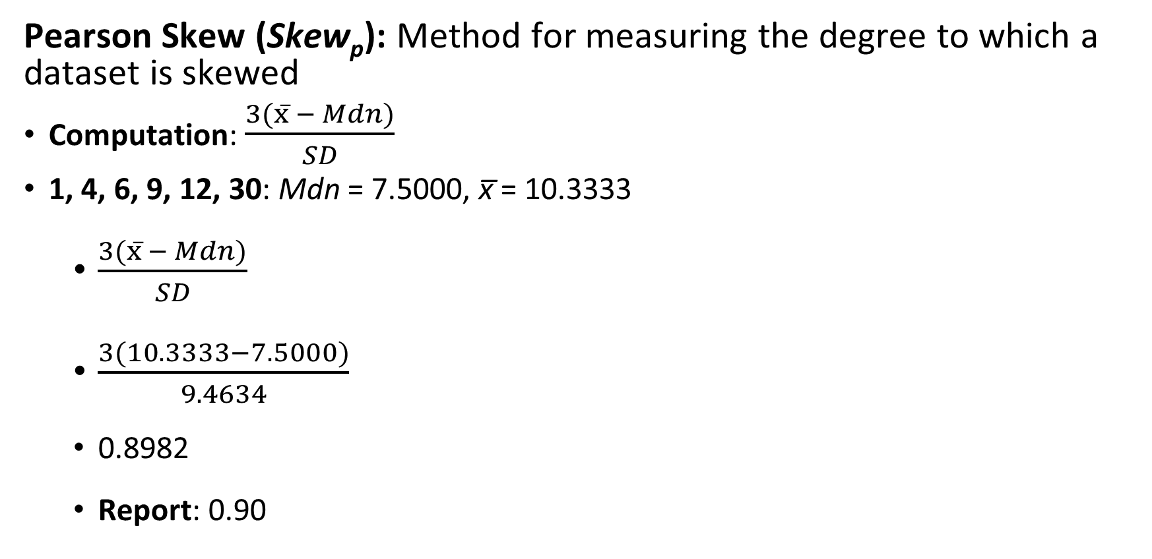
Skewed Distributions
Pearson Skew (Skew_{p}): Method for measuring the degree to which a dataset is skewed
Computation: $\frac{3(x̅ − Mdn)}{SD}$
1, 4, 6, 9, 12, 30: Mdn = 7.5000, x̅ = 10.3333
$\frac{3(x̅ − Mdn)}{SD}$
$\frac{3(10.3333−7.5000)}{9.4634}$
0.8982
Report: 0.90

Slide 115
Skewed Distributions
Pearson Skew (Skew_{p}): Method for measuring the degree to which a dataset is skewed
Skew_{p} | Description | Metrics
0 up to |.5| | Normal | Mean & SD
|.5| up to |1.0| | Mild Skew | Mean & SD
|1.0| up to |1.5| | Moderate Skew | Mean & SD
|1.5| up to |2.0| | Strong Skew | Median & MAD
|2.0| or greater | Severe Skew | Median & MAD

Slide 116
https://chadcwilliams.shinyapps.io/StatsProblemGenerator/

Slide 117
Lecture Outline
Distributions
Central Tendency
Mode
Median
Mean
Variability
Range
SIQR
MAD
SD
Skewed Distributions
Reporting Descriptives

Slide 118
Reporting Descriptive Statistics
DV
IV
We collected student exam scores for online statistical classes that were either performed asynchronously or synchronously. For the asynchronous group, the mean exam score was x̅ = 80% (SD = 16%) and the synchronous group, the mean exam score was x̅ = 85% (SD = 12%). Thus, although similar, exam scores for the synchronous group seemed to be higher than for the asynchronous group.
x̅
SD
x̅
SD
Conclusion
in words

Slide 119
Reporting Descriptive Statistics
We collected student exam scores for online statistical classes that were either performed asynchronously or synchronously. For the asynchronous group, the mean exam score was x̅ = 80% (SD = 16%) and the synchronous group, the mean exam score was x̅ = 85% (SD = 12%). Thus, although similar, exam scores for the synchronous group seemed to be higher than for the asynchronous group.

Slide 120
Symbols so far:
General:
N = Sample Size
X_{o} = Observed Value
X_{t} = True value
X_{e} = Error
Central Tendency:
Mod = mode
Mdn = median
x̅ = mean
Variability:
SIQR = Semi-Interquartile Range (Q_{75%}, Q_{25%})
SS = Sums of squares
SD² = Variance
SD = Standard Deviation
Skew_{p} = Pearson Skew

Slide 121
Extra Resources

Slide 122
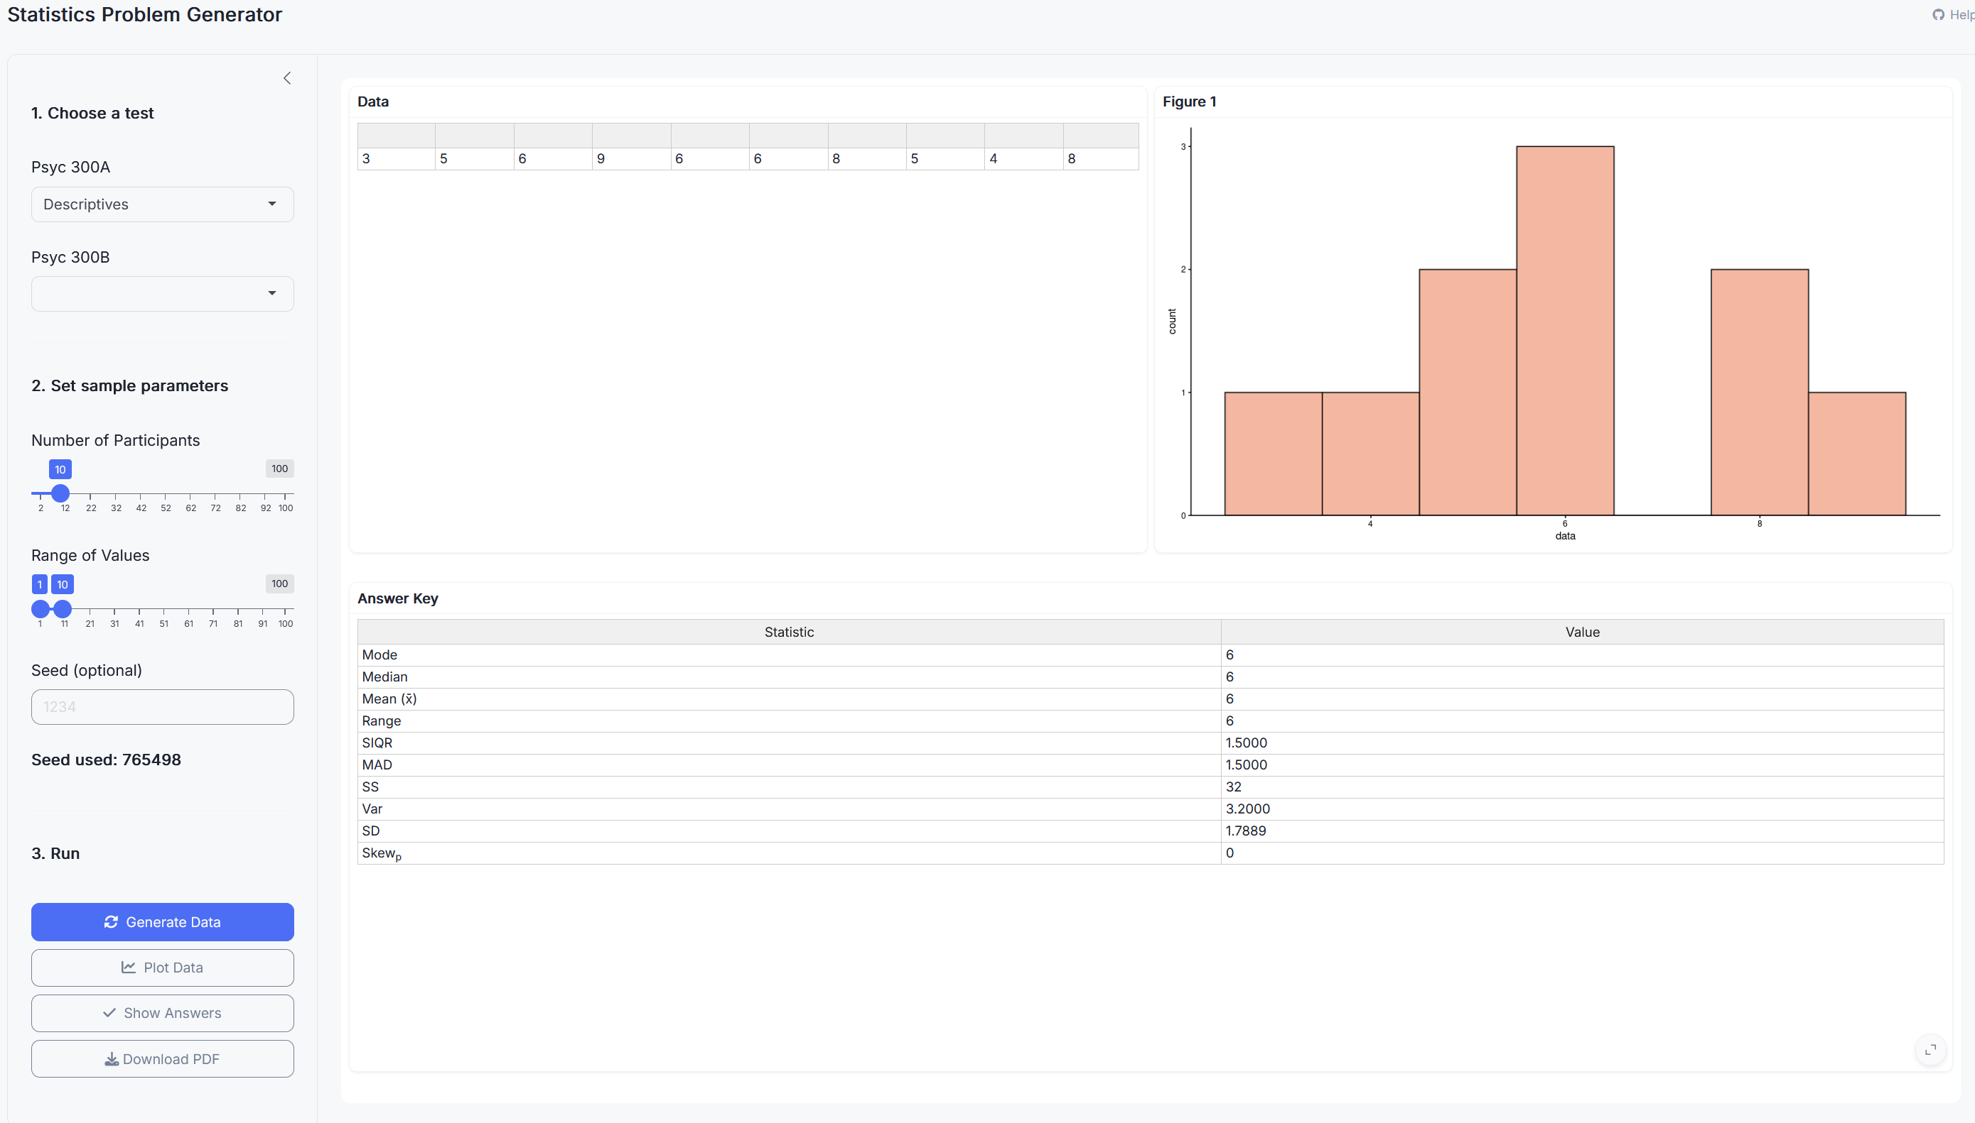
Stats Problem Generator
https://chadcwilliams.shinyapps.io/StatsProblemGenerator/

Slide 123
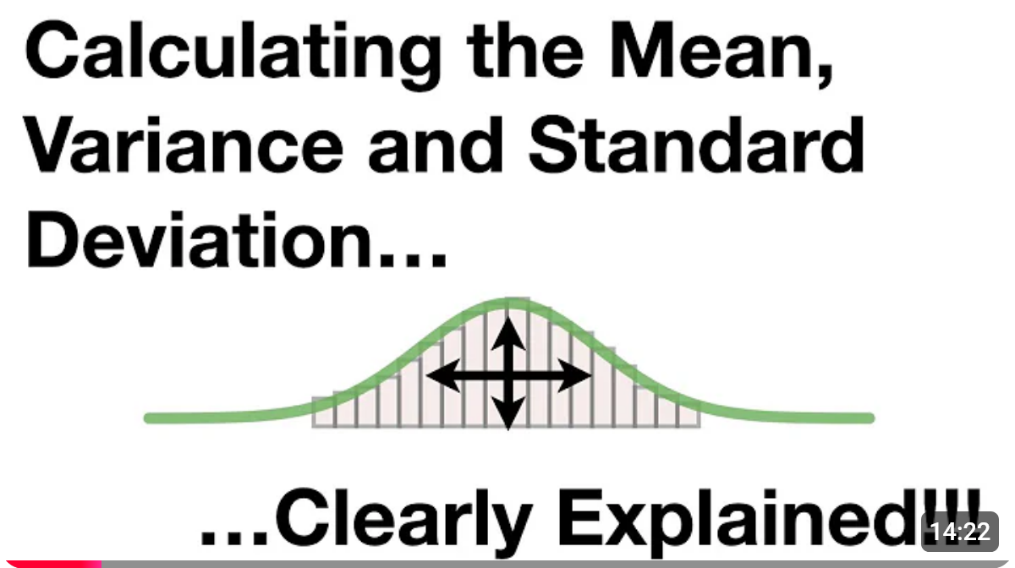

Extra Resources
Note: This video uses a slightly different equation for variance (they use n-1 instead of n). This is something we will cover in future lectures. For now, just use n, not n-1

